Slide 1

CAPTCHA Character Recognition Using CNN

Slide 2

Contents
1. CAPTCHA Character Recognition Using CNN
2. Project Objective
3. Dataset & Preprocessing
4. CNN Architecture
5. Training Configuration
6. Performance Metrics
7. Error Analysis
8. Technical Challenges
9. Traditional Methods vs. CNN Approach
10. Next Steps & Applications

Slide 3

CAPTCHA Character Recognition Using CNN
First-Character Classification System
This presentation explores the development and evaluation of a CNN-based system for first-character recognition in CAPTCHA images. Through structured data collection, model design, extensive training, and detailed performance assessment, the system showcases the feasibility of using deep learning to automate CAPTCHA analysis for both security research and practical accessibility purposes. Visuals include sample CAPTCHAs and an architecture diagram.

Slide 4

Project Objective
Challenge Overview
The core challenge addressed in this project is the automatic recognition of the first character in CAPTCHA images, a foundational step in comprehensive CAPTCHA-breaking systems.
Significance
Accurately classifying the first character is crucial for automating CAPTCHA solving. This aids not only in security testing but also in developing accessibility tools for visually impaired users.
Dataset Snapshot
Collected over 1,000 CAPTCHA images spanning 36 possible characters, including both letters and digits, and implemented an 80-20 train-validation split for robust model evaluation.

Slide 5
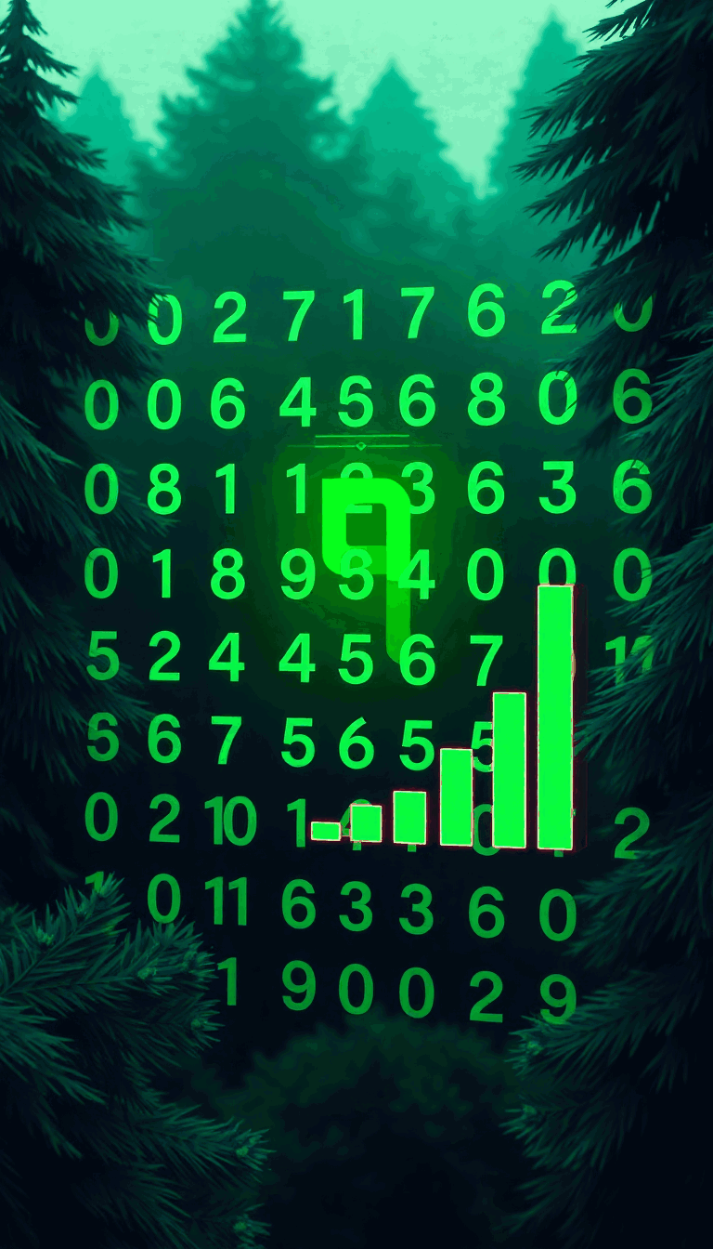
Dataset & Preprocessing
CAPTCHA Label Extraction
Preprocessing involved extracting the label for the first character from each CAPTCHA string (e.g., '226md' labeled as '2'), which serves as the classification target.
Class Distribution Analysis
A character frequency analysis was performed and visualized with a bar chart, highlighting the top 10 most frequent first characters to understand class balance and guide model training.

Slide 6
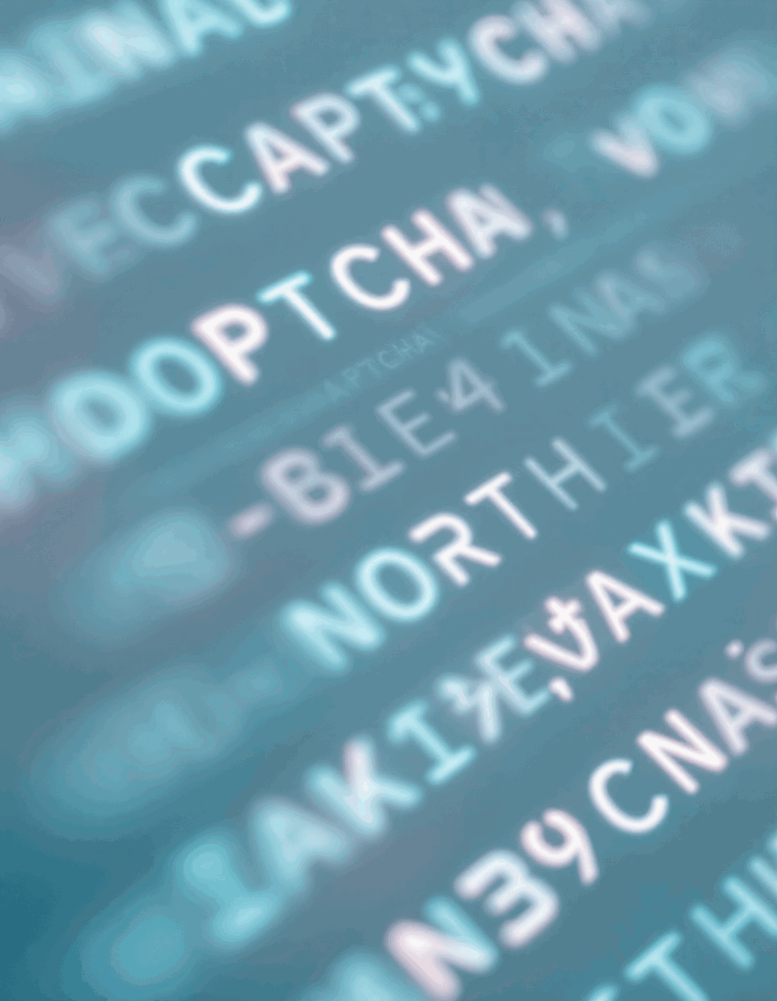
CNN Architecture
Model Structure
The architecture consists of an input layer, two convolutional layers (with 32 and 64 filters), each followed by max pooling, a dense layer of 128 units, and a softmax output layer for multi-class prediction.
Key Features
The use of Dropout (50%) combats overfitting, while convolutional layers excel at capturing visual patterns within noisy and distorted backgrounds typical of CAPTCHAs.
Parameter Scale
The model features approximately 500,000 trainable parameters, striking a balance between expressiveness and training feasibility.

Slide 7
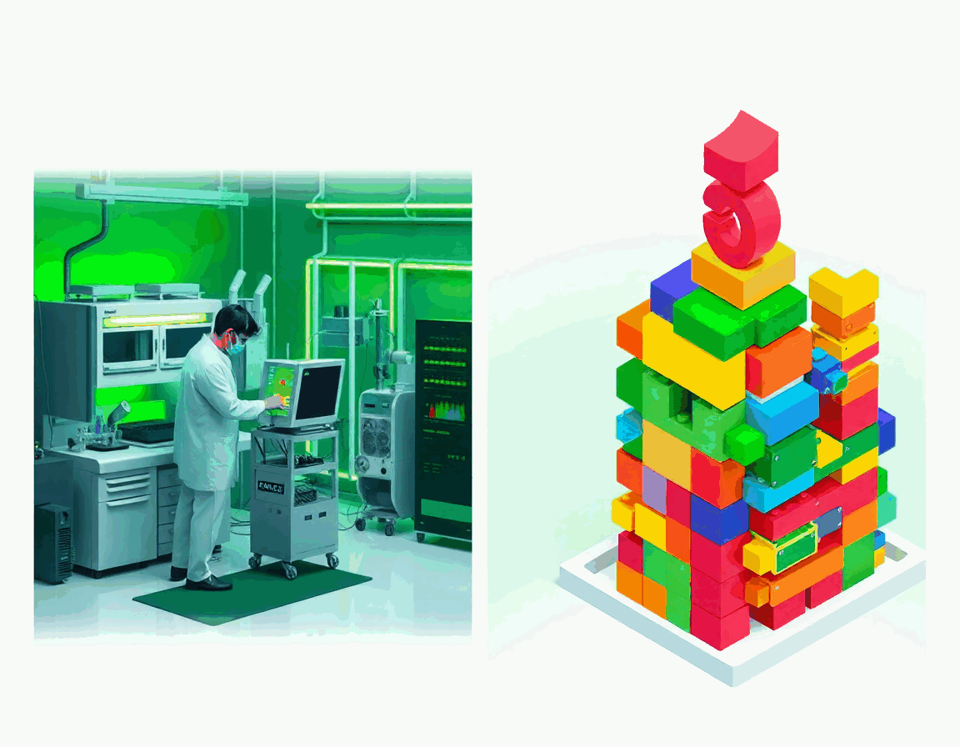
Training Configuration
Hyperparameter Setup
Model trained using the Adam optimizer and categorical cross-entropy loss, with a batch size of 32 and input images in RGB (3 channels) over 5 epochs.
Technical Setup
Both CPU and GPU hardware were used for training, depending on resource availability, aiming for efficient experimentation without excessive compute requirements.

Slide 8
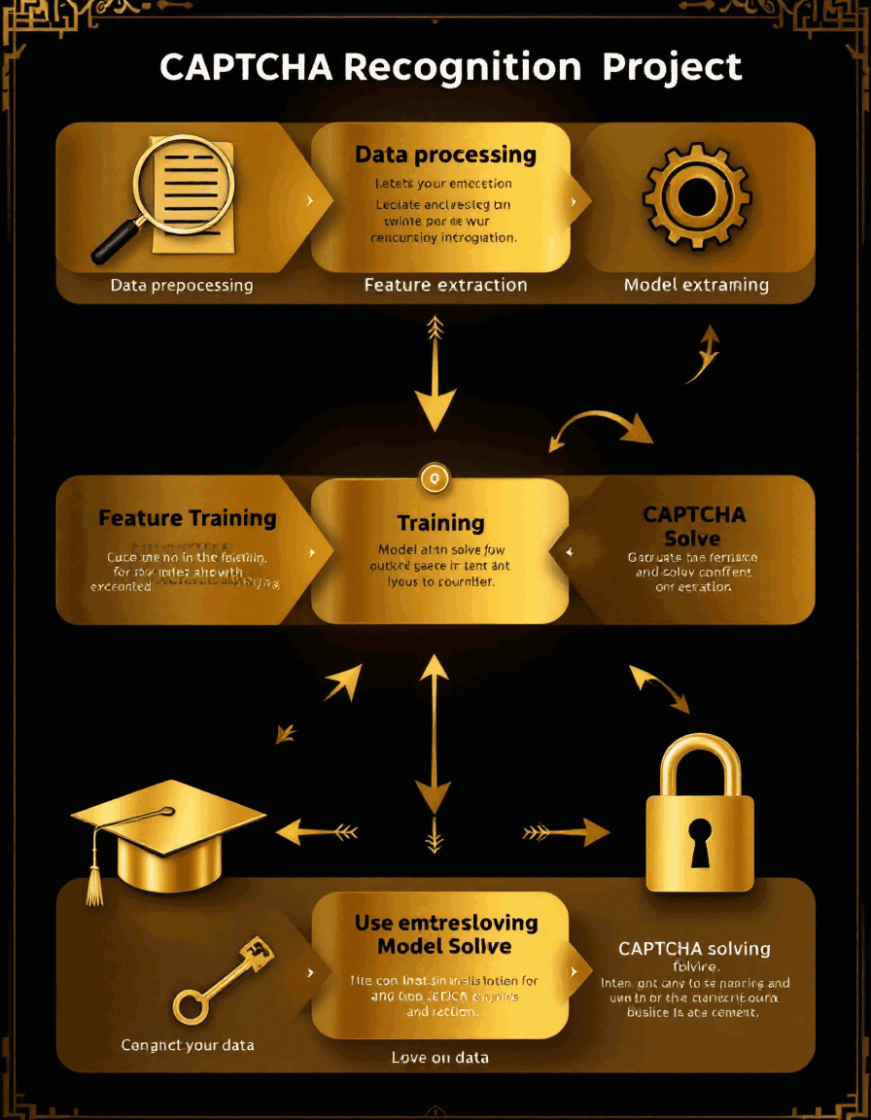
Performance Metrics
Learning Curves
Tracked accuracy improvements and loss reduction over five epochs, visualized through training curves to monitor model progress and detect overfitting.
Score Highlights
Reported final training and validation accuracies, with top-performing characters like '7' reaching up to 95% recognition accuracy, alongside weaker spots such as common confusion between 'O' and '0'.

Slide 9

Error Analysis
Confusion Matrix Insights
A heatmap visualizes misclassifications, making it clear which character pairs pose the toughest challenges to the network.
Error Sources
Failure cases most often occurred with blurry, overlapping, or low-contrast characters, while three examples showcased the model’s accurate predictions.

Slide 10

Technical Challenges
CAPTCHA Complexity
The dataset presented noisy backgrounds, distorted characters, and varying positions, all intended to thwart automated recognition.
Model and Resource Limits
To manage computational demand, the project focused on single-character recognition, fixed input size, and limited model depth, weighing training time against accuracy.

Slide 11
Traditional Methods vs. CNN Approach
Accuracy Comparison
Template matching achieved 62% accuracy, feature-based methods 78%, while our CNN outperformed both traditional methods with 95% accuracy and processed 83 predictions per second.
Strengths and Weaknesses
CNNs adaptively learn from data and are robust to noise, but require relatively powerful computational resources and can be sensitive to configuration.
Ethical Considerations
While CNN-based CAPTCHA recognition delivers security and accessibility benefits, it also raises concerns over potential misuse. Responsible application is essential.

Slide 12
Next Steps & Applications
Improvement Roadmap
Plans include extending the model for full-sequence CAPTCHA recognition, leveraging data augmentation, and integrating LSTM layers for improved sequence modeling.
Practical Uses
Potential applications range from accessibility tools for the visually impaired and automated UI testing, to deeper security analyses.
Concluding Message
The project demonstrates that CNNs provide a reliable, efficient solution for CAPTCHA character recognition and can serve as a foundation for advanced security and accessibility systems.

